Slide 1
C++ Part II
X52.9265-01
Yedidiah Solowiejczyk
Week#6
New York University
School
of
Professional and Continuous Studies
4/11/11
C++ Part II

Slide 2
Synopsis
Inheritance Basics
  Derived classes
  Constructors in derived classes
  Protected qualifier
  Redefining member functions
  Redefining vs. Overloading
  Access to Redefined Base functions
  Non-inherited functions
Programming with Inheritance
  Assignment operators and copy constructors in derived classes
  Destructors in derived classes
Class within classes – Composition
  “is-a” vs. “has a”
  Inheritance Syntax
  Constructor Initialize List
  Order of constructor & destructor calls
Composition vs. inheritance
Private Inheritance
Protected Inheritance
Multiple Inheritance
4/11/11
C++ Part II

Slide 3
Introduction to Inheritance
One of the most compelling features about C++ is code reuse without the use of “copy and paste”
C++ programming provides various powerful programming techniques for reusability of code:
inheritance:
  Inheritance is the process by which new classes called derived classes are created from existing classes called base classes.
  The derived classes have all the features of the base class and the programmer can choose to add new features specific to the newly created derived class
  It models the “is-a” relationship – e,g. class Student can be derived from the class Person
composition:
  composition or aggregation allows software to be developed by assembling existing components rather than creating new ones.
  It models the “has-a” relationship – e.g. a class employee can contain an object of type salary
4/11/11
C++ Part II

Slide 4
Inheritance Basics
Base class
  "General" class from which others derive
Derived class
  New class
  Automatically has base class’s:
    Member variables
    Member functions
  Can then add additional functionality via new member functions and variables
Example:
  Specialized versions inherit properties of
  general class
  Adds to it/modify it’s functionality for it’s
  appropriate use
class Person{ // Base Class
int age;
char name[32];
};
class Student{ // Derived Class
int grade;
int student_id;
};
class Employee{ // Derived Class
float salary;
int employee_id;
};
4/11/11
C++ Part II

Slide 5
Inheritance Basics
Inherited Members
  A derived class automatically has all the member variables and all the ordinary member functions of the class (not constructors and assignment operators)
  When discussing derived classes, it is common to refer to the :
    Base Class is typically called the “parent”
      Parent of a parent class ➔ “ancestor” class
    Derived Class is typically called the “child” class
      Child of a child class ➔ “descendant” class
Person
int age;
char name[20];
Student
Int grade;
Int Student Id;
4/11/11
C++ Part II

Slide 6
Base Class Attributes
Base class
  "General" class from which others derive
class Person{ // Base Class
int age; // private qualifier
protected: // new qualifier
char name[32];
public:
//constructors & destructors
Person( ); //default constructor
Person(int Age, char * Name); //parametrized constructor
~Person( ){ }
Person( const Person &); //copy constructor
//mutator and accessor
void setAge(int Age);
void setName(char *Name)
int getAge( ) const;
char *getName( ) const;
// other member functions
void Print( ){printf(“Base Class:name = %\n age = %d\n”, name, age);}
};
4/11/11
C++ Part II

Slide 7
Derived Class Attributes
Derived class
  New class derived from parent class
class Employee: public Person{ // derived class
private:
int id;
float salary;
public:
//constructors & destructors
Employee ( ); //default constructor
Employee (int Age, char * Name, int Age, float Salary);
~Employee ( ){ }
Employee ( const Employee &); //copy constructor
//mutator and accessor
int getId( ) const;
float geSalary( ) const;
// other member functions
void Print( ){printf(“Derived Class: name = %s age = %d\n id = %d\n
salary = %6.2f %d\n”,name, age, id, salary);}
};
All public members (except constructors/overloaded assignment in Base Class are inherited as public. Private member in base class are not directly accessible. Protected members are directly accessible
4/11/11
C++ Part II

Slide 8
Private vs. Protected Qualifier
protected:
New classification of class members
Allows access "by name" in derived class
  But nowhere else - no access "by name" in other classes as well as outside of class
In class where it’s defined ➔ acts like private
"protected" in derived class has been created so that:
  To allow future derivations of derived class
If private members in derived classes could be accessed directly, then each base class would be vulnerable to be “accessed” by simple derived class that inherits base class publicly
Members defined in the protected section of a class are accessible in member and friend functions of the class, and in member and friend functions of classes derived from the class. These members are inaccessible in any other function.
Many feel this "violates" information hiding (accessor/mutator functions)
4/11/11
C++ Part II

Slide 9
Derived Class Attributes
Derived class – public inheritance
  “is a” relation – student “is a” person
class Student: public Person { // Derived Class
protected: //allow derived classes to inherit this value
int grade;
int studentId;
public:
//constructors & destructors
Student ( ); //default constructor
Student ( int Age, char * Name, int grade, int Id)
~Student ( ){ }
Student ( const Student &); //copy constructor
//mutator and accessor
void setGrade(int Age){age = Age;}
void setStudentId(char *Name){strcpy(name, Name;}
// other member functions
void Print( ); // redefined Print( ) function
};
Data member belonging to Person
Data member belonging to Student
4/11/11
C++ Part II

Slide 10
Redefinition of Member Functions
Recall interface of derived class:
  Contains declarations for new member functions
  Contains declarations for new member data
  Contains declarations for inherited member functions to be redefined
  Inherited member functions NOT declared:
    Automatically inherited unchanged
Implementation of derived class will:
  Define new member functions
  Redefine inherited functions as declared
4/11/11
C++ Part II

Slide 11
Review of Overloading Functions
Function Overloading. If you have two or ore function definitions for the same function name and different signatures, then they are overloaded. The function signature that matches the invocation is used.
Overloading based on call-by-reference. Overloading based on a distinction between a reference parameter and a value parameter is not supported.
Overloading and Automatic Type Conversion. When a method is called in C++, it looks to match the method signature. If it fails to match the signature exactly, C++ will try to do a conversion to match. For example, it may convert an int into a double to match for a signature. This has the potential to cause problems within a program.
You Cannot Overload Based on the Type Returned. A method can not be overloaded based on the return type of the method. Overloading is only concerned with the parameters for a method, not the return types.
4/11/11
C++ Part II

Slide 12
Redefining vs. Overloading
Redefining in derived class:
  SAME parameter list and same return type
    Essentially "re-writes" same function
Overloading in derived class:
  Different parameter list (signature)
      Defined "new" function that takes different parameters
        Sequence of types in parameter list
        Including order, number, types)
        Signature does NOT include:
    Return type
    const keyword or &
One can say that anytime you redefine an overloaded function name from the base class, all the other versions are automatically hidden in the new class.
If you change the interface of the base class by modifying the signature and/or return type of a member function from the base class, then you are using inheritance primarily to reuse code, and not to maintain the common interface of the base class.
4/11/11
C++ Part II

Slide 13
Redefining Example§
class X{
private:
// data members data #1
public:
//constructors, etc
:::::::::::::::
// member functions
int tax( int sum){ return sum*0.0825;}
};
class Y: public X{
private:
// data members data #2
public:
//constructors, etc
:::::::::::::::
int tax(int sum){return sum*0.09;} //redefined
}
int main( )
{
X X1; //base class
Y Y1; //derived class
int tax1 = X1.tax(100); // 8.25% tax
int tax2 = Y1.tax(1000); //10% tax
int tax3 = Y1.X::tax(1000); // trying to underpay taxes
}
§ - see example Redefine_Inh.cpp
4/11/11
C++ Part II

Slide 14
Name Hiding Example§
class Mammal{
public:
// constructors
Mammal() { std::cout << "Mammal constructor...\n"; }
~Mammal() { std::cout << "Mammal destructor...\n"; }
//Other methods
void Move() const
{ std::cout << "Mammal move one step\n"; }
void Move(int distance) const //overloaded { std::cout << "Mammal move " << distance <<" steps.\n"; }
protected:
int itsAge;
int itsWeight;
};
/*************** Results ****************/
Mammal constructor...
Mammal constructor...
Dog constructor...
Mammal move one step
Mammal move 2 steps.
Dog move xxx steps.
Dog destructor...
Mammal destructor...
Mammal destructor
§ - see also Eckel Chapter 14
class Dog : public Mammal
{
public:
// Constructors
Dog(){ std::cout << "Dog constructor...\n"; }
~Dog(){ std::cout << "Dog destructor...\n"; }
// Other methods
//Hiding a function
void Move() const
{ std::cout << "Dog move xxx steps.\n"; }
};
int main()
{
Mammal bigAnimal;
Dog fido;
bigAnimal.Move();
bigAnimal.Move(2);
fido.Move();
// fido.Move(10); //compiler error
return 0;
}
Redefine an overloaded function name in base, all other versions are hidden
4/11/11
C++ Part II

Slide 15
Functions Not Inherited
All "normal " functions in base class are
inherited in derived class
Exceptions:
  Constructors
  Destructors
  Copy constructor
  If not defined, compiler generates "default" one
    Recall need to define one for pointers!
  Assignment operator
    If not defined ➔ compiler provides default
A constructor for a derived class uses a base class constructor in a special way.
A constructor for a base class initializes all the data
A constructor for a derived class begins with an invocation of the constructor of the base class as illustrated:
Student ( int Age, char * Name, int grade, int Id):Person(Age, cha* Name)
4/11/11
C++ Part II

Slide 16
Constructors in Derived Classes
Constructors in base class are not inherited in derived class
Constructor for derived class begins with an invocation of constructor for the base class§
Example:
Note: If constructor definition of derived class does not invoke invocation of a constructor for the base class, then default constructor will be invoked automatically.
§ - see posted Example Student.cpp, Person.h
class X
{
protected:
int a;
public:
X( ):a(0){ }
X(int A) : a(A){ }
};
class Y: public X
{
private:
int b;
public:
Y( ):X( ){ } //default constructor
Y(int A, int B):X(A), b(B);
};
Base default constructor
4/11/11
C++ Part II

Slide 17
Assignment Operator Derived Class
operator=( ) doesn’t inherit because it performs a constructor-like activity
class Person{
int age;
char name[32];
public:
//constructors, destructors and copy constructors
//Base Class Assignment Operator
Person & operator=(const Person rhs){
age = rhs.age;
strcpy(name,rhs.name);
}
};
class Student: public Person{
int grade, id;
public:
//constructors, destructors and copy constructors
::::::::::::::::::::::::::::::
//Derived class assignment operator= ( )
Student & operator=(const Student &rhs){
Person::operator=(rhs);
grade = rhs.grade;
id = rhs.id;
}
};
4/11/11
C++ Part II

Slide 18
Copy Constructor in Derived Classes
Derived::Derived(const Derived& Object)
: Base(Object), …
{…}
After : is invocation of base copy constructor
Sets inherited member variables of derived class object being created
  Note Object is of type Derived;
  but it’s also of type Base, so argument is valid
4/11/11
C++ Part II

Slide 19
Destructors in Derived Classes
If base class destructor functions correctly
  Easy to write derived class destructor
When derived class destructor is invoked:
  Automatically calls base class destructor!
  So no need for explicit call
Derived class destructors need only be
concerned
  using delete on derived class variables (and any data they "point" to)
  Base class destructor handles inherited data
  automatically via use of its own delete
4/11/11
C++ Part II

Slide 20
Destructor Calling Order
Consider:
class B derives from class A
class C derives from class B
A ← B ← C
When object of class C goes out of scope:
  Class C destructor called 1st
  Then class B destructor called
  Finally class A destructor is called
  A ➔ B ➔ C
Opposite of how constructors are called
4/11/11
C++ Part II

Slide 21
Inheritance and static member functions
static member functions act the same as non-static member functions:
  They inherit into the derived class.
  If you redefine a static member, all the other overloaded functions in the base class are hidden.
  If you change the signature of a function in the base class, all the base class versions with that function name are hidden (this is really a variation of the previous point).
  However, static member functions cannot be virtual (a topic covered next time)
4/11/11
C++ Part II

Slide 22
"Is a" vs. "Has a" Relationships
Inheritance – “is a”
  Considered an "Is a" class relationship
  e.g.
  An Student "is a” Person
  A Convertible "is a" Automobile
Composition – “has a”
A class contains objects of another class as it’s member data
  Considered a “has a" class relationship
  e.g.
  One class "has a" object of another class as it’s data
  A Student “has a” date object
4/11/11
C++ Part II

Slide 23
Pointers and Inheritance
class X
{
protected:
int a;
public:
X( ):a(0){ }
X(int A) : a(A){ }
};
class Y: public X
{
private:
int b;
public:
Y( ):X( ){ }
Y(int A, int B):X(A), b(B);
};
int main( )
{
X X1(5); //OK
Y Y1(20);
X *X_ptr = new X(15); //OK
Y *Y_ptr = new Y(15,10); //OK
X *X1_ptr = &X1; //OK
X *X2_ptr = &Y1;
}
4/11/11
C++ Part II

Slide 24
Composition vs. Inheritance
Composition is generally used when you want the features of an existing class inside your new class, but not its interface.
That is, you embed an object to implement features of your new class, but the user of your new class sees the interface you’ve defined rather than the interface from the original class.
To do this, you follow the typical path of embedding private objects of existing classes inside your new class.
4/11/11
C++ Part II

Slide 25
Composition Example§
class Point2D{
private:
int m_nX;
int m_nY;
public:
//constructors
Point2D(int nX, int nY)
: m_nX(nX), m_nY(nY) { }
:::::::::::::::::::::::::::
};
§ - see posted Example Main_Creature.cpp
class Creature{
private:
std::string m_strName;
//COMPOSITION
Point2D m_cLocation;
public:
//constructors
Creature(std::string strName, const Point2D &cLocation): m_strName(strName), m_cLocation(cLocation){ }
};
int main(){
std::string cName;
Creature cCreature(cName, Point2D(4, 7)); }
4/11/11
C++ Part II

Slide 26
Protected Inheritance
class Student : protected Person{…}
Public members in base class become protected in derived class
Protected derivation means “implemented-in-terms-of” to other classes but “is-a” for derived classes and friends.
It’s something you don’t use very often, but it’s in the language for completeness.
In real projects there are times when you want to make something hidden from the world at large and yet allow access for members of derived classes.
The protected keyword is a nod to pragmatism; it says, “This is private as far as the class user is concerned, but available to anyone who inherits from this class.”
4/11/11
C++ Part II

Slide 27
Protected Inheritance
#include <stdio.h>
#include <iostream>
using namespace std;
class ZooAnimal{
public:
ZooAnimal( ){cout << "default ZooAnimal" << endl;}
void locate(){cout << "ZooAnimal locate( )" << endl;};
void inform( ){cout << "ZooAnimal: inform( )" << endl;}
};
class Bear : public ZooAnimal
{
public:
Bear( ) : ZooAnimal( ){cout << "Bear Creation" << endl;}
};
class Rodent : protected ZooAnimal{ // ~ ADT
int flag;
Rodent( ); //private default constructor
public:
Rodent(int Flag ): flag(Flag) {
cnt++;
cout << "creating Rodent - " << cnt << endl;
}
static int cnt;
void assuringMsg( ){cout << "Rodent: assuringMsg: " << endl;}
protected:
void reportSighting();
};
class Rat : public Rodent{
public: //
Rat(int Flag ): Rodent(Flag){cout << "Constructor Rat Prop" << endl;}
protected: //
};
class Mouse: public Rodent{
public: //
Mouse(int Flag ): Rodent(Flag){cout << "Constructor Mouse Prop" << endl;}
protected: //
};
int Rodent::cnt = 0;
int main(){
Bear anyBear;
Rat anyRat1(0), anyRat2(0);
Mouse anyMouse(0);
//Rodent anyRodent;
anyBear.inform( ); //ok ZooAnimal member func
anyBear.locate( ); //ok ZooAnimal member func
anyRat1.assuringMsg( ); // ok nonpublic
anyRat2.assuringMsg( ); // ok nonpublic
anyMouse.assuringMsg( ); // ok nonpublic
//anyRat[0].locate( ); //nok - protected
} /******************** Results *******************/
default ZooAnimal
Bear Creation
default ZooAnimal
creating Rodent - 1
Constructor Rat Prop
default ZooAnimal
creating Rodent - 2
Constructor Rat Prop
default ZooAnimal
creating Rodent - 3
Constructor Mouse Prop
ZooAnimal: inform( )
ZooAnimal locate( )
Rodent: assuringMsg:
Rodent: assuringMsg:
Rodent: assuringMsg:
4/11/11
C++ Part II

Slide 28
Private Inheritance
class SalariedEmployee : private Employee
{…}
All members in base class become private in derived class
  Difficult to use base class properties
You can inherit a base class privately by leaving off the public in the base-class list, or by explicitly saying private (probably a better policy because it is clear to the user that you mean it).
When you inherit privately, you’re “implementing in terms of;” that is,
  you’re creating a new class that has all of the data and functionality of the base class, but that functionality is hidden, so it’s only part of the underlying implementation.
  The class user has no access to the underlying functionality, and an object cannot be treated as a instance of the base class
Note: Protected & Private inheritance, the base class is only a tool to be used in the derived class
4/11/11
C++ Part II

Slide 29
Private Inheritance
class Pet {
public:
char eat() const { return 'a'; }
int speak() const { return 2; }
float sleep() const { return 3.0; }
float sleep(int) const { return 4.0; }
};
class Goldfish : private Pet {
// Private inheritance
public:
using Pet::eat; // Name publicizes member
using Pet::sleep; // Both overloaded members exposed
};
int main() {
Goldfish bob;
bob.eat();
bob.sleep();
bob.sleep(1);
}//private inheritance is useful if you want to hide part of the functionality of the base class.
If you want any of them to be visible, just say their names (no arguments or return values) along with the using keyword in the public section of the derived class
4/11/11
C++ Part II

Slide 30
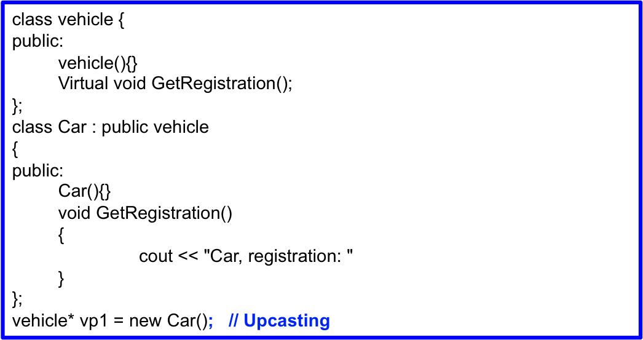
Upcasting
An object can be used as its own type or as an object of its base type.
In addition it can be manipulated through an address of the base type.
Taking the address of an object (either a pointer or a reference) and treating it as the address of the base type is called upcasting because of the way inheritance trees are drawn with the base of the class at the top.
Upcasting is always safe because you’re going from a more specific type to a more general type – the only thing that can occur to the class interface is that it can lose member functions, not gain them. This is why the compiler allows upcasting without any explicit casts or other special notation.
4/11/11
C++ Part II

Slide 31
Multiple Inheritance
Multiple inheritance enables a derived class to inherit members from more than one parent.
Example
  class Bed{int weight;};
  class Sofa{int weight;};
class SleeperSofa : public Bed, public Sofa{ };
Typically problem is best solved by using single inheritance
Multiple inheritance can introduce ambiguities
Name Collision
Application has to know what it inherits from each base object
Bed
int weight;
void sleep( )
Sofa
int weight;
void watch( )
int main( ){
SleeperSofa X;
X.sleep( ); //OK
X.watch( );
X.foldOut( );
cout << X.weight; //NOK
cout << X.Sofa::weight;//OK
}
SleeperSofa
void foldOut( )
4/11/11
C++ Part II

Slide 32
Multiple Inheritance & Dreadful Triangle
Base
int data_;
Base
Der1
Complete Join
Der1
Der2
Base
Der2
Join
Join
4/11/11
C++ Part II

Slide 33
Multiple Inheritance & Dreadful Triangle
class Base {
public:
Base():data_(0){cout << "Default Base Constructor\n";};
protected:
int data_;
};
class Der1 : public Base
{
public:
Der1( ):Base( ){cout << "Der1 default constructor\n";}
};
class Der2 : public Base
{
public:
Der2( ):Base( ){cout << "Der2 default constructor\n";}
};
class Join : public Der1, public Der2 {
public:
Join( ):Der1( ), Der2( ){cout << "Join Default Constructor\n";}
void method()
{
//data_ = 1; // bad: this is ambiguous
}
};
int main()
{
Join X;
}
/*********************** Results **************************
Default Base Constructor
Der1 default constructor
Default Base Constructor
Der2 default constructor
Join Default Constructor
Base
int data_;
Der1
Der2
Join
4/11/11
C++ Part II

Slide 34
Dreadful Triangle & Virtual Inheritance
Base
int data;
Base
Der1
Complete Join
Der1
Der2
Der2
Join
Join
4/11/11
C++ Part II

Slide 35
Dreadful Triangle & Virtual Inheritance §
class Base {
public:
Base():data_(0){cout << "Default Base Constructor\n";};
protected:
int data_;
};
class Der1 : virtual public Base {
public:
Der1( ):Base( ){cout << "Der1 default constructor\n";}
};
class Der2 : virtual public Base {
public:
Der2( ):Base( ){cout << "Der2 default constructor\n";}
};
class Join : public Der1, public Der2 {
public:
Join( ):Der1( ), Der2( ){cout << "Join Default Constructor\n";}
void method()
{
data_ = 1; // bad: this is ambiguous; see below
}
};
int main()
{
cout << "Creating Join Directly\n";
Join X;
cout << "Creating Join via Base Class pointer\n";
Base* b = new Join( );
}
§ - see posted Diamond.cpp
Base
int data_;
Der1
Der2
Join
Creating Join Directly
Default Base Constructor
Der1 default constructor
Der2 default constructor
Join Default Constructor
Join via Base Class pointer
Default Base Constructor
Der1 default constructor
Der2 default constructor
Join Default Constructor
4/11/11
C++ Part II

Slide 36
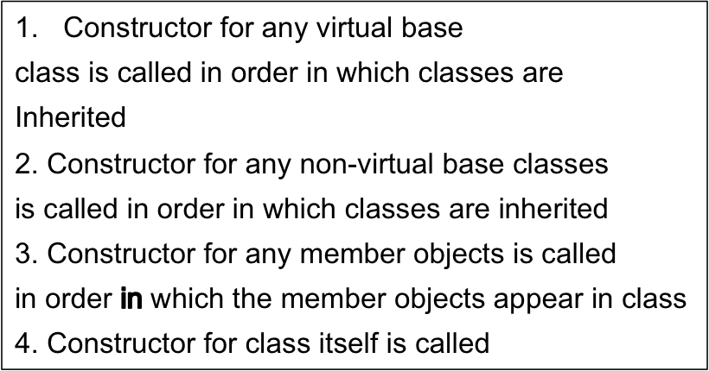
Constructing Objects of Multiple Inheritance
The rules for constructing objects to handle inheritance
Endanger Species
ZooAnimal
Bear
Panda ying_yang;
ZooAnimal Consructor
Bear Constructor
Endangered Species Constructor
Panda Constructor
Panda
4/11/11
C++ Part II

